Slide 1


SHIELD INSURANCE ANALYSIS

Slide 2
Agenda
About This Project
About
Data Sets
Project Dashboard
Key Insights
End
Presentation Title

Slide 3

About Project
Throughout my internship at Atliq Hardware, I had the privilege of working with Shield Insurance Company's data. My primary responsibility entailed the conversion of this data into invaluable insights aimed at enhancing their business strategies. This project not only enriched my learning experience but also provided remarkable clarity about the workings of the corporate world.

Slide 4
About Data Sets
Fact_premiums
Dim_date
1.date:
2. customer_code:
3. Policy_id:
4. sales_mode:
5. final_premium_amt(INR)
1.Date 2.mmm_yy 3. day_type 4. week_no:
Dim_customer
1.customer_code
2.dob
3.city
Dim_Policies
Fact_settlements
1.policy_id 2.Base_covrage_amt
3.Base_premium_amt
1. age
2. settlement%

Slide 5
NOV22 DEC22 JAN 23 FEB 23 MAR 23 APR 23
DATE
City
Chennai Delhi NCR Mumbai Indore And Hyderabad
Policies
POL4321HEL
POL4331HEL
POL3309HEL
POL5319HEL
POL6303HEL
POL6093HEL
POL9221HEL
POL1048HEL
POL2005HEL
Sales-Mode
Offline-Agent
Offline_Direct
Online_App
Online_Website
Age-Groups
11-20 21-30 31-40 41-50 50-60 OVER 60

Slide 6


Slide 7
Key Insights
📊 Highest revenue and number of customers achieved in March 2023.
👥 The age group of 31-40 contributed the most to both revenue and customer growth.
🌆 Delhi NCR emerged as the top city in terms of revenue and customer numbers.
🤝 Offline agents were the primary source of customer generation.
📈 Offline-direct and online app modes are showing steady growth trends.
🏆 POL4321HEL policy is the most preferred by customers. 🚀

Slide 8
Skills Acquired
🤝 Effective client communication.
🎨 Creating and sharing project mockups for client input.
📈 Providing step-by-step updates and gathering feedback.
📊 Designing attractive dashboards (light background, spacing, suitable visuals).
📢 Crafting clear and understandable client presentations.
📊 Building three distinct Power BI dashboards using Excel data.

Slide 9
“A person who never made a mistake never tried anything new.“
—Albert Einstein. ...

Slide 10


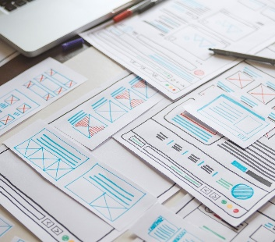
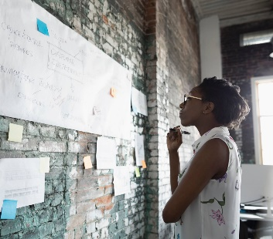
"Thank you for watching till the end, Your feedback is invaluable to me. I hope you found it informative and engaging " 🎉
Mohammad Ayaan Alam mr.ayaan.dev.gmail.com
6202741771

